Slide 1
Computer and Network Security COMP 5370/637* Lecture #6 August 28, 2015
Tony Skjellum
skjellum@auburn.edu

Slide 2
Today’s Topics
TCP/IP Primer
Socket Programming
Assignment

Slide 3
Recap
What Dr.Skjellum discussed on Monday
Contrasting OSI model and TCP/IP
Network topology

Slide 4
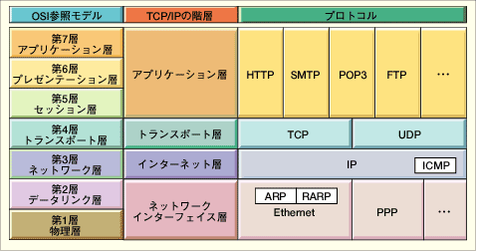
TCP/IP – Protocols in each layer
OSI Model
TCP/IP Hierarchy
Protocols
7th
Application Layer
6th
Presentation Layer
Application Layer
5th
Session Layer
4th
Transport Layer
Transport Layer
3rd
Network Layer
Network Layer
2nd
Link Layer
Link Layer
1st
Physical Layer

Slide 5
TCP/IP –Role of each layer
Link Layer : includes device driver and network interface card
Network Layer : handles the movement of packets, i.e. Routing
Transport Layer : provides a reliable flow of data between two hosts
Application Layer : handles the details of the particular application
Link & Network perform basic mechanics of transferring blocks of data across and between networks – They are foundation blocks.
Link & Network layers are used only by protocol stack but not by applications that are run over TCP/IP.

Slide 6
TCP/IP – Role of Internet Protocol
IP is the bedrock protocol of TCP/IP.
Every message and every piece of data sent over any TCP/IP Network is sent as an Ippacket.
Connectionless protocol
IP packet has header and Data.
Total 20 bytes

Slide 7
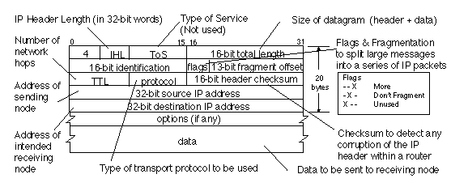
Fields IP packet Header

Slide 8
TCP/IP – TCP & UDP
TCP - Transmission control protocol
UDP - User Datagram protocol

Slide 9
TCP - Transmission control protocol
Connection oriented protocol
Features Error Check and recovery
Three way Handshake
Data is exchanged as byte stream
Data remains intact and arrives in the same order sent – Flow control

Slide 10
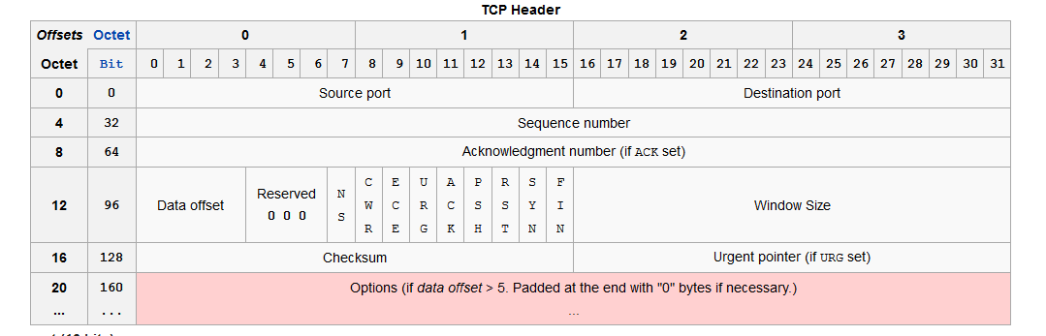
TCP Header

Slide 11
UDP – User Datagram Protocol
Connectionless protocol
Data is exchanged as packets
Features error checking but no recovery
No handshake
No Flow control

Slide 12
Socket Programming
An interface between application and network
The application creates a socket to communicate
Components of a socket are as follows -Protocols, Types and functions

Slide 13
Socket Programming : Analogy
Socket: telephone
Bind: assign telephone number to a telephone
Listen: turn on the ringer so that you can hear the phone call
Connect: dial a phone number
Accept: answer the phone
Read/write: talking

Slide 14
Socket Programming : Types
SOCK_STREAM
a.k.a. TCP
reliable delivery
in-order guaranteed
connection-oriented
bidirectional
SOCK_DGRAM
a.k.a. UDP
unreliable delivery
no order guarantees
no notion of “connection” – app indicates dest. for each packet
can send or receive
App
App
D1
3
2
1
socket
Dest.
3
2
D2
1
socket
D3

Slide 15
Socket Programming
Once socket is configured the application can
pass data to the socket for network transmission
receive data from the socket (transmitted through the network by some other host)
The socket type dictates the style of communication
>reliable vs. fast
>connection-oriented vs. connectionless

Slide 16
Socket Creation in C: socket
Creating the interface / socket
#include <sys/socket.h>
int socket(int family, int type, int protocol);
Family: AF_INET > internet domain
Type: SOCK_STREAM (TCP) SOCK_DGRAM (UDP)
Protocol: = 0 (OS decides protocol when this is zero)
Return descriptor, -1 on error

Slide 17
Socket Programming - Ports
Each host has 65,536 ports
Some ports are reserved for specific apps
20,21: FTP
23: Telnet
80: HTTP
see RFC 1700 (about 2000 ports are reserved)

Slide 18
Socket binding
int status = bind(sockid, &addrport, size);
status: error status, = -1 if bind failed
sockid: integer, socket descriptor
addrport: struct sockaddr, the (IP) address and port of the machine (address usually set to INADDR_ANY – chooses a local address)
size: the size (in bytes) of the addrport structure

Slide 19
Listen and Accept
int status = listen(sock, queuelen);
status: 0 if listening, -1 if error
sock: integer, socket descriptor
queuelen: integer, # of active participants that can “wait” for a connection
listen is non-blocking: returns immediately
int s = accept(sock, &name, &namelen);
s: integer, the new socket (used for data-transfer)
sock: integer, the orig. socket (being listened on)
name: struct sockaddr, address of the active participant
namelen: sizeof(name): value/result parameter
must be set appropriately before call
adjusted by OS upon return
accept is blocking: waits for connection before returning

Slide 20
Socket : connect call
int status = connect(sock, &name, namelen);
status: 0 if successful connect, -1 otherwise
sock: integer, socket to be used in connection
name: struct sockaddr: address of other machine
namelen: integer, sizeof(name)
connect is blocking

Slide 21
Send & Receive
With a connection (SOCK_STREAM):
int count = send(sock, &buf, len, flags);
count: # bytes transmitted (-1 if error)
buf: char[], buffer to be transmitted
len: integer, length of buffer (in bytes) to transmit
flags: integer, special options, usually just 0
int count = recv(sock, &buf, len, flags);
count: # bytes received (-1 if error)
buf: void[], stores received bytes
len: # bytes received
flags: integer, special options, usually just 0
Calls are blocking [returns only after data is sent (to socket buf) / received]

Slide 22
Socket : close()
When finished using a socket, the socket should be closed:
status = close(s);
status: 0 if successful, -1 if error
s: the file descriptor (socket being closed)
Closing a socket
closes a connection (for SOCK_STREAM)
frees up the port used by the socket

Slide 23
sockaddr
The generic:
struct sockaddr {
u_short sa_family;
char sa_data[14];
};
sa_family
specifies which address family is being used
determines how the remaining 14 bytes are used
The Internet-specific:
struct sockaddr_in {
short sin_family;
u_short sin_port;
struct in_addr sin_addr;
char sin_zero[8];
};
sin_family = AF_INET
sin_port: port # (0-65535)
sin_addr: IP-address
sin_zero: unused

Slide 24
Sockets DEMO

Slide 25
Useful links & References
TCP/IP primer
http://www.ipprimer.com/#/overview
http://courses.cs.washington.edu/courses/cse550/10au/other_for_site/tcpip.pdf
https://en.wikipedia.org/wiki/Internet_protocol_suite
http://www.erg.abdn.ac.uk/users/gorry/course/inet-pages/ip-packet.html
Socket Programming
http://beej.us/guide/bgnet/output/print/bgnet_A4.pdf

Slide 26
Assignment
Write TCP/IP client-server socket programs such that when client sends two numbers, server replies with the sum in programming language of your choice. (C, C++, Java)
Source code must be submitted with build info
This is individual assignment.
Date of Submission – 2nd September 2015 (next week -Wednesday)

